Slide 1

Department of
Computer Sc. & Engineering
Welcome to Final Project Presentation
Research and Prediction of Stock Market by Algorithmic Trading using Machine Learning
Submitted By
Bishal Mohanty (Regd. No. 2001209106)
Subhojit Das (Regd. No. 2001209208)
Abhijit Mishra (Regd. No. 2001209062)
Group #
CSE 29
Under the Supervision of
Dr. Bhagwat Prasad Chaudhury
Senior Assistant Professor, Department of CSE

Slide 2
Background of the Study
Algorithmic trading, often referred to as algo trading, is a method of executing trades using automated pre-programmed trading instructions. These instructions can be based on various factors such as price, timing, quantity, or any mathematical model.
It employs quantitative analysis techniques to identify patterns and make predictions. Regulatory
Algorithmic trading is utilized across various financial markets, including stocks, bonds, currencies (forex), commodities, and derivatives
Objective
This offers novel proposals on the following
Machine Learning Integration
Natural Language Processing (NLP) for Sentiment Analysis
Further progress can be made in the areas like
Machine Learning and Artificial Intelligence
Natural Language Processing (NLP) and Sentiment Analysis
Quantum Computing
High-Frequency Trading (HFT) Strategies

Slide 3
Problem Statement : Stock Selection Challenges
Overview:
Choosing profitable stocks from a vast selection is complex and time-consuming.
Manual selection methods are prone to oversight, leading to missed opportunities or suboptimal choices.
Challenges:
Identifying lucrative investment opportunities amidst numerous stocks.
Ensuring efficient and effective decision-making in stock selection processes.
Impact:
Delayed investment decisions.
Potential for missed profit opportunities.
Suboptimal portfolio performance.

Slide 4
Work Flow Diagram
Data Collection
(Web Scraping YF)
Data Preprocessing
Data Visualization
(Seaborn, Matplotlib)
ML Model Building and Training
Logistic
Regression
LSTM
MACD
Model Deployment
(Streamlit)
Website Creation
(HTML/CSS)

Slide 5
Method
Approach: Integration of Web Scraping from Yahoo Finance using python libraries with ML models using LR,SVC,LSTM and MACD Algorithms for Algorithmic Trading. Prepared and trained separately then compared together for finding best accuracy.
Software/Tools Used: Jupyter Notebook for Python, Apache Kafka, Javascript, HTML/CSS, Streamlit, Yahoo Finance

Slide 6
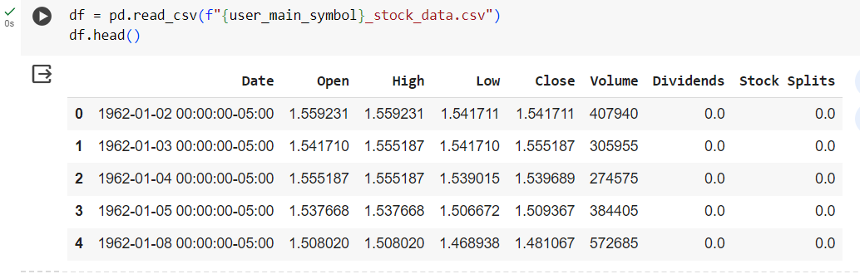
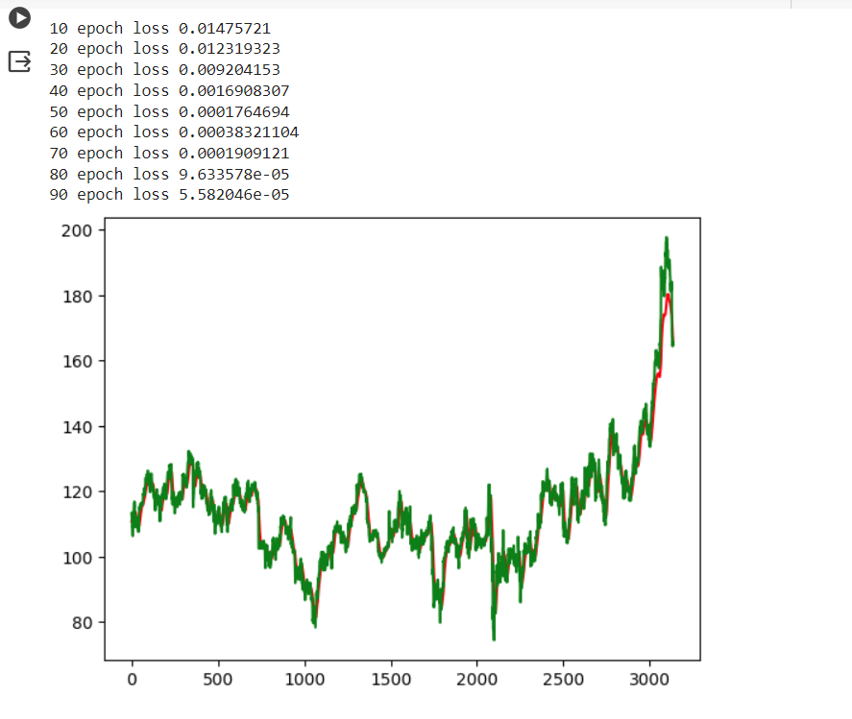
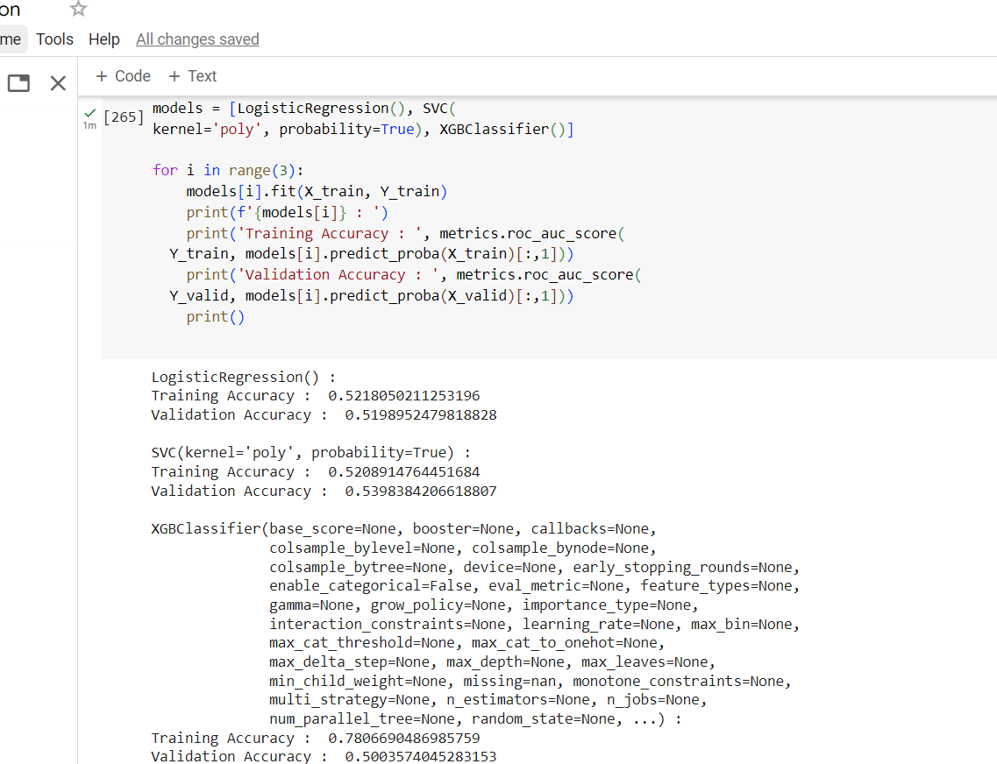
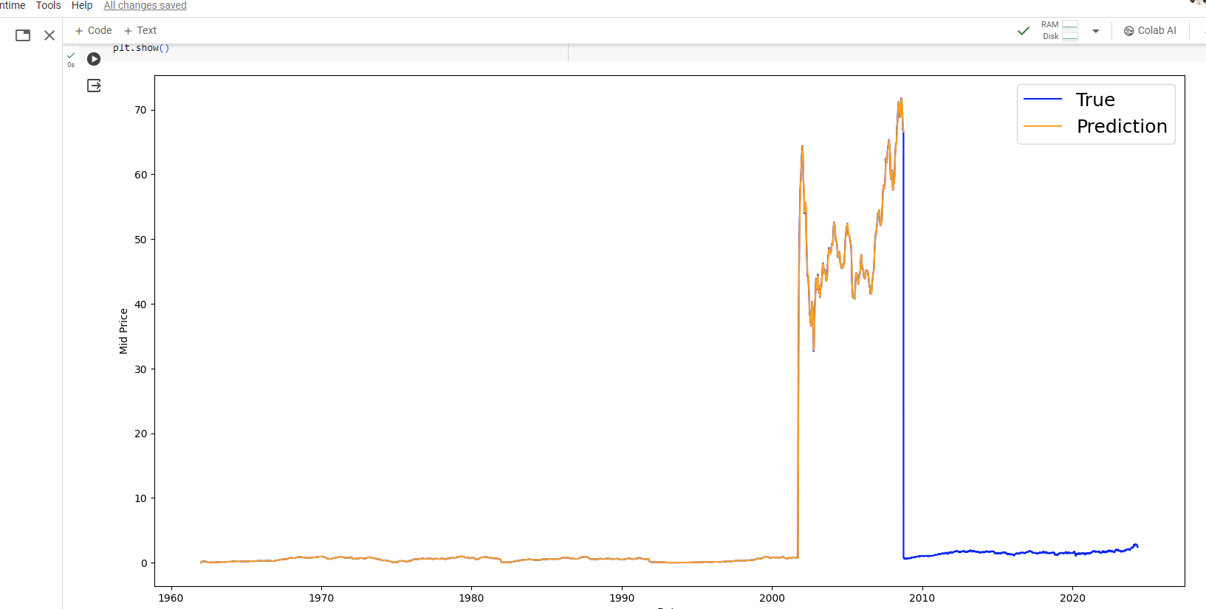
Results Obtained

Slide 7
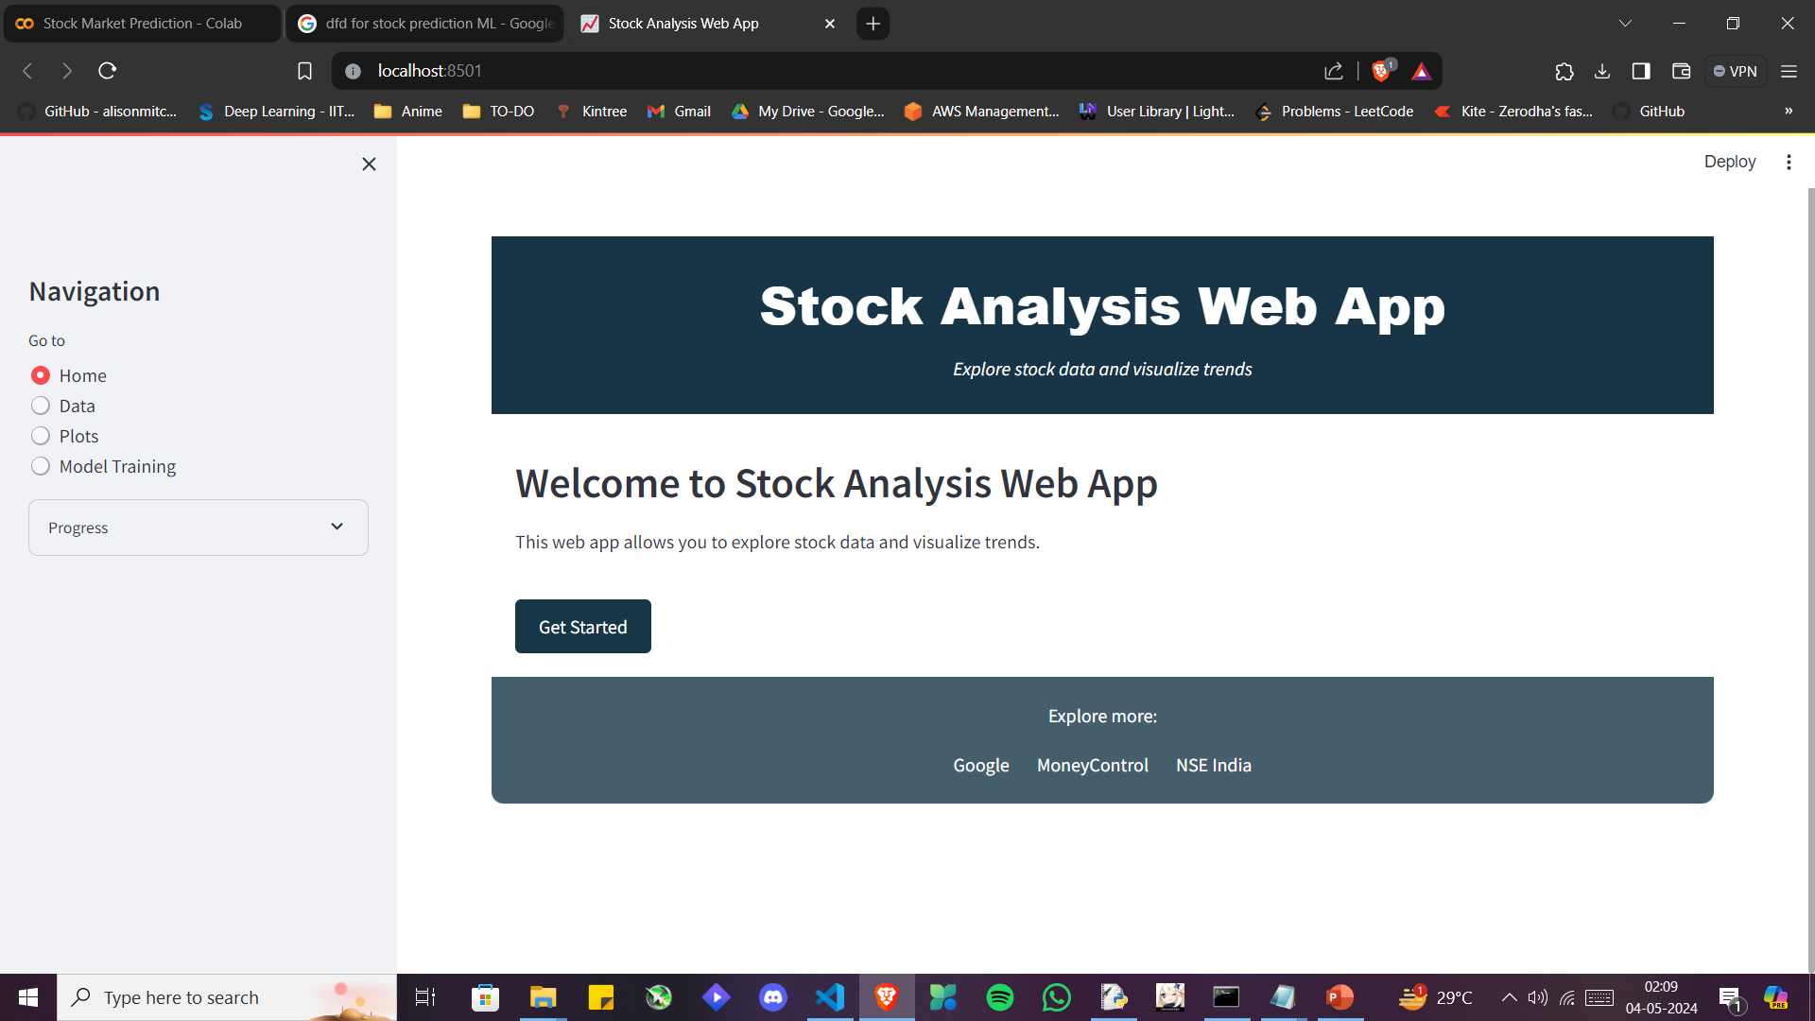
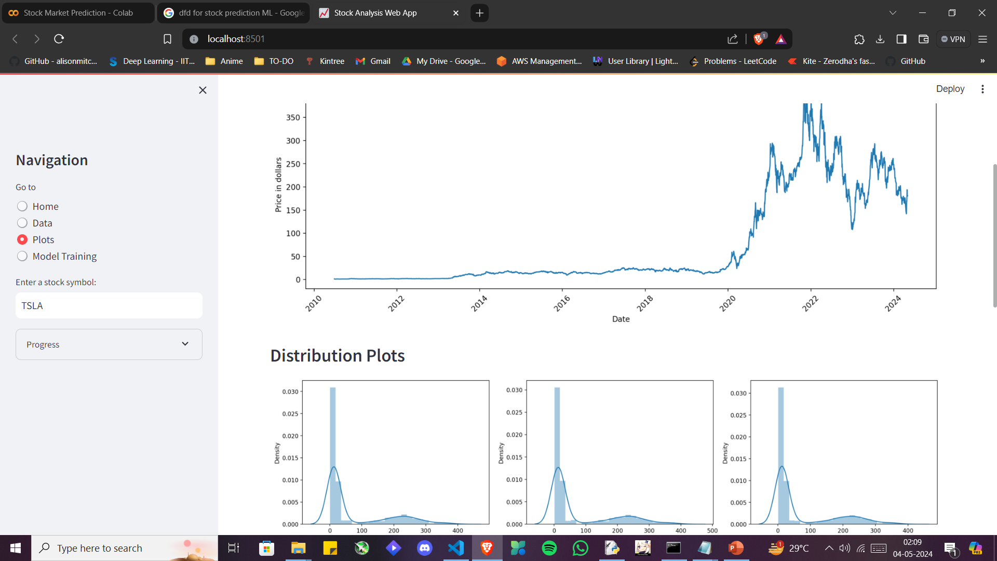

Slide 8
Our Contribution
The rise of algorithmic trading with machine learning has led to sophisticated algorithms that analyze vast market data to improve trading decisions.
This work focuses on integrating machine learning models into trading strategies, enhancing predictive accuracy and profitability in financial markets.
Algorithmic trading with machine learning has enhanced market efficiency, liquidity, and accessibility. These systems analyze real-time data to identify trends, manage risks, and optimize trading strategies.
This results in more stable financial markets, increased investment opportunities, and improved capital allocation, promoting economic growth.
Algorithmic trading with machine learning has improved market efficiency, reduced transaction costs, and provided access to diverse investment opportunities. By leveraging advanced analytics, traders can make informed decisions, mitigate risks, and optimize portfolio performance, leading to better returns and greater stability in financial markets.

Slide 9
Conclusion and Future works
Algorithmic trading with machine learning showcases superior adaptability and predictive power over traditional methods. Despite notable benefits in efficiency and profitability, challenges like model interpretability, overfitting, and regulatory scrutiny persist. Nevertheless, this integration signifies a substantial leap forward, enabling better risk management and personalized trading strategies in intricate financial landscapes
The Work Ahead
Future enhancements in machine learning-driven algorithmic trading include:
Deep Reinforcement Learning: Utilizing deep RL to develop adaptive trading agents that learn optimal strategies in dynamic environments.
Ensemble Methods: Integrating ensemble learning techniques to combine predictions from multiple models for improved accuracy and robustness.
Online Learning: Implementing online learning algorithms to continuously update models and adapt to changing market conditions in real-time.
Explainable AI: Incorporating explainable AI techniques to enhance transparency and interpretability of trading decisions.

Slide 10
Project Timeline
5/4/2024
Jan
Feb
Mar
Research on topics and models
Building the models and testing them
Ensemble the different models
Silicon Institute of Technology, Bhubaneswar
10

Slide 11
References
[1] Tsui, E., Law, K. K., & Yeung, D. Y. (2018). "Machine Learning in Finance: From Theory to Practice." Springer.
[2] Zhang, Y., Zhao, X., & Lai, K. (2018). "Machine Learning in Financial Markets: A Comprehensive Study." International Journal of Financial Studies, 6(2), 29.
[3] Lim, Y., & Mulyadi, M. (2020). "The Use of Machine Learning Algorithms in Algorithmic Trading: A Systematic Review." Journal of Reviews on Global Economics, 9, 293-305.
[4] Cartea, Á., Jaimungal, S., & Penalva, J. (2018). "Algorithmic and High-Frequency Trading." Cambridge University Press.

Slide 12




